Slide 1
LHD: Improving Cache Hit Rate By Maximizing Hit Density
Nathan Beckmann
CMU
Haoxian Chen
U. Penn
Asaf Cidon
Stanford &
Barracuda Networks
USENIX NSDI 2018

Slide 2

Key-value cache is 100X faster than database
Web Server
10 ms
100 µs

Slide 3
Key-value cache hit rate determines web application performance
At 98% cache hit rate:
+1% hit rate → 35% speedup
  Old latency: 374 µs
  New latency: 278 µs
  Facebook study [Atikoglu, Sigmetrics ’12]
Even small hit rate improvements cause significant speedup

Slide 4
Choosing the right eviction policy is hard
Key-value caches have unique challenges
  Variable object sizes
  Variable workloads
Prior policies are heuristics that combine recency and frequency
  No theoretical foundation
  Require hand-tuning ➔ fragile to workload changes
No policy works for all workloads
  Prior system simulates many cache policy configurations to find right one per workload [Waldspurger, ATC ‘17]

Slide 5
goal:
Auto-tuning eviction policy across workloads

Slide 6
The “big picture” of key-value caching
Goal: Maximize cache hit rate
Constraint: Limited cache space
Uncertainty: In practice, don’t know what is accessed when
Difficulty: Objects have variable sizes

Slide 7


Where does cache space go?
Time $⇒$
Let’s see what happens on a short trace…
… A B B A C B A B D A B C D A B C B …
A
A
A
A
A
A
B
B
B
B
B
B
B
C
Hit! ☺
Space $⇒$
…
Eviction! ☹
Y
Y
Y
Y
Y
X
X
X
X
X

Slide 8


Where does cache space go?
Time $⇒$
Green box = 1 hit
Red box = 0 hits
➔ Want to fit as many green boxes as possible
Each box costs
resources = area
➔ Cost proportional to size & time spent in cache
… A B B A C B A B D A B C D A B C B …
A
A
A
A
C
C
B
B
B
C
B
B
B
Hit! ☺
Space $⇒$
…
Eviction! ☹
A
B
B
Y
D
D
X

Slide 9
The Key Idea:
Hit Density

Slide 10

Our metric: Hit density (HD)
Hit density combines hit probability and expected cost
Least hit density (LHD) policy: Evict object with smallest hit density
But how do we predict these quantities?
$$Hit density=\frac{{Object}^{′}s hit probability}{{Object}^{′}s size×Object^{′}s expected lifetime}$$

Slide 11
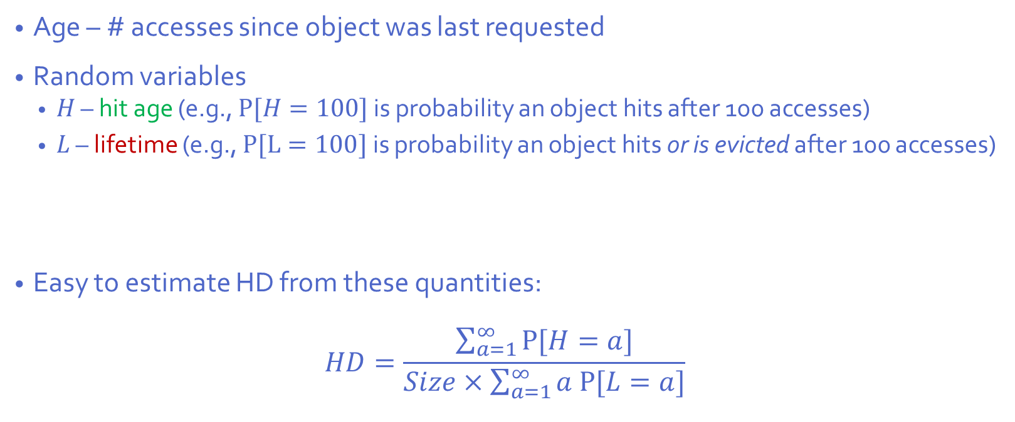


Estimating hit density (HD)
Age – # accesses since object was last requested
Random variables
  $H$ – hit age (e.g., $P[H=100]$ is probability an object hits after 100 accesses)
  $L$ – lifetime (e.g., $P[L=100]$ is probability an object hits or is evicted after 100 accesses)
Easy to estimate HD from these quantities:
$$HD=\frac{\sum_{a=1}^{∞}{P[H=a]}}{Size×\sum_{a=1}^{∞}{a P[L=a]}}$$
$$hit probability$$
$$expected lifetime$$

Slide 12
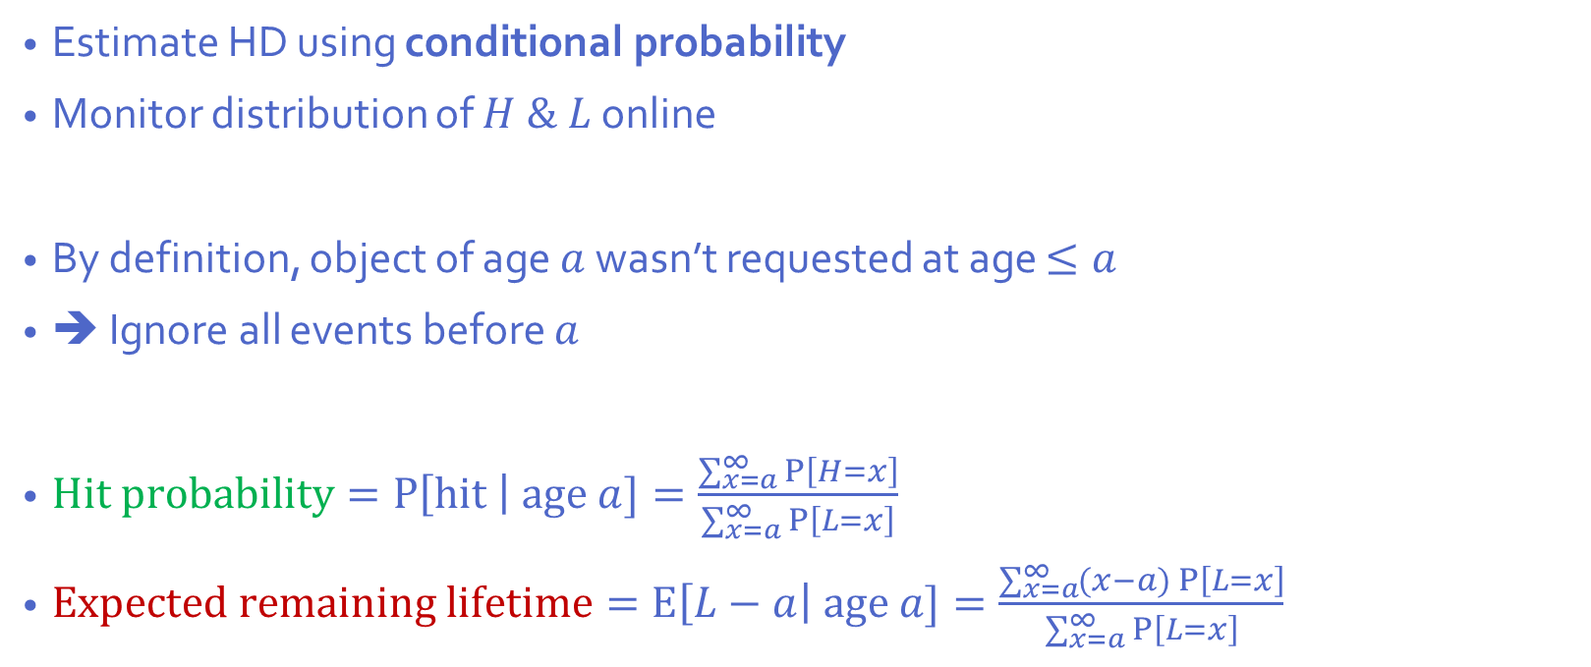

Example: Estimating HD from object age
Estimate HD using conditional probability
Monitor distribution of $H \& L$ online
By definition, object of age $a$ wasn’t requested at age $≤a$
➔ Ignore all events before $a$
$Hit probability=P\left[hit \right| age a]=\frac{\sum_{x=a}^{∞}{P\left[H=x\right]}}{\sum_{x=a}^{∞}{P\left[L=x\right]}}$
$Expected remaining lifetime=E\left[L−a\right| age a]=\frac{\sum_{x=a}^{∞}{(x−a) P\left[L=x\right]}}{\sum_{x=a}^{∞}{P\left[L=x\right]}}$
Hit probability
Age
Candidate age $a$

Slide 13
LHD by example
Users ask repeatedly for common objects and some user-specific objects
More popular
Less popular
Common
User-specific
Best hand-tuned policy for this app:
Cache common media + as much user-specific as fits

Slide 14
Probability of referencing object again
Common object modeled as scan, user-specific object modeled as Zipf

Slide 15
LHD by example: what’s the hit density?
Hit density large & increasing
Hit density small & decreasing
High hit probability
Older objs
closer to
peak ➔
expected
lifetime
decreases
with age
Older objects are probably unpopular ➔
expected lifetime increases with age
Low hit probability

Slide 16
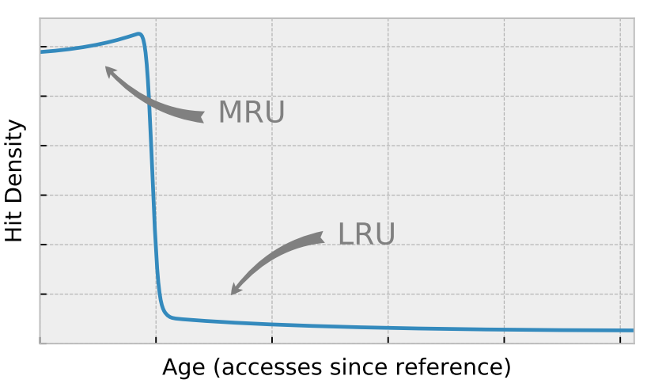
LHD by example: policy summary
Hit density large & increasing
Hit density small & decreasing
LHD automatically implements the best hand-tuned policy:
First, protect the common media, then cache most popular user content

Slide 17
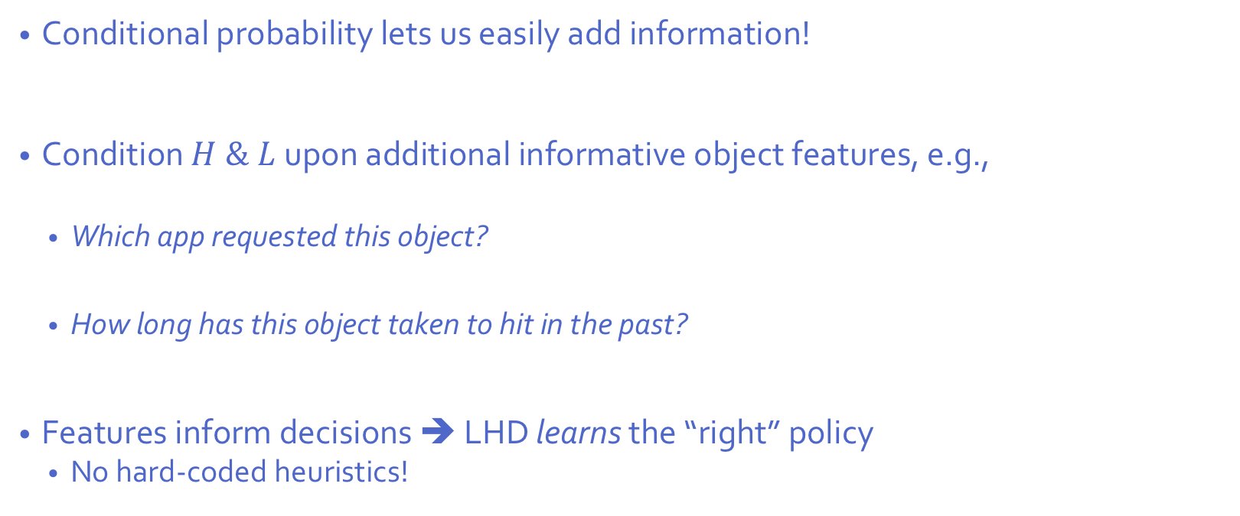
Improving LHD using additional object features
Conditional probability lets us easily add information!
Condition $H \& L$upon additional informative object features, e.g.,
  Which app requested this object?
  How long has this object taken to hit in the past?
Features inform decisions ➔ LHD learns the “right” policy
  No hard-coded heuristics!

Slide 18
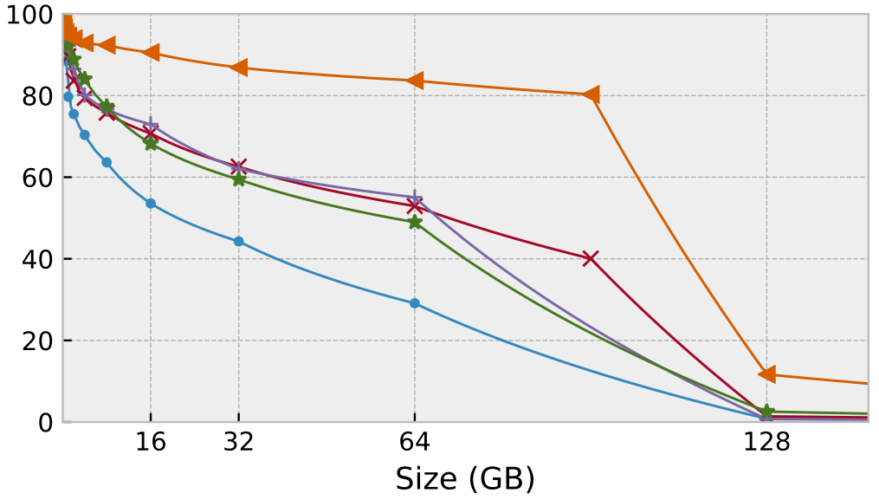

LHD gets more hits than prior policies
Lower is better!

Slide 19
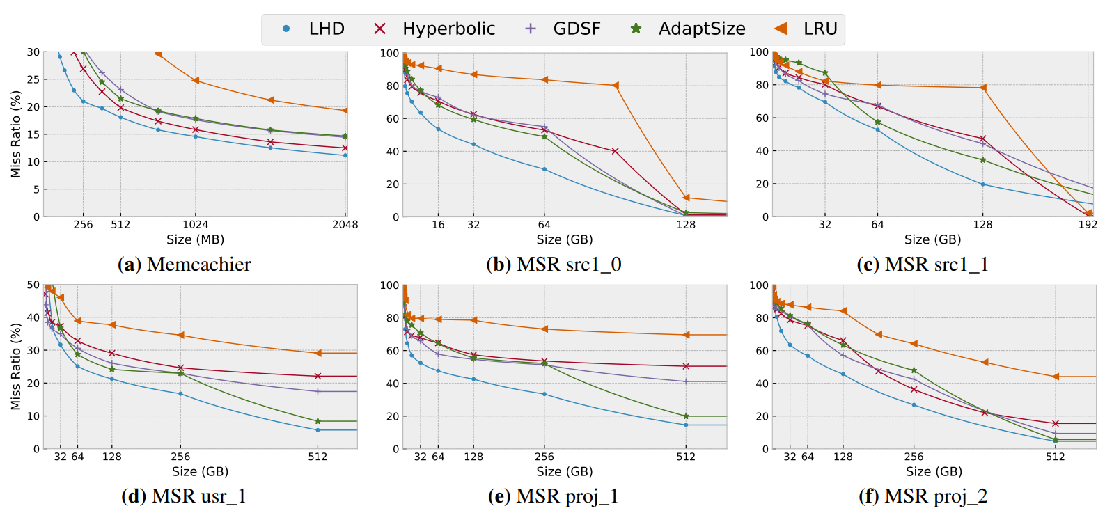
LHD gets more hits across many traces

Slide 20
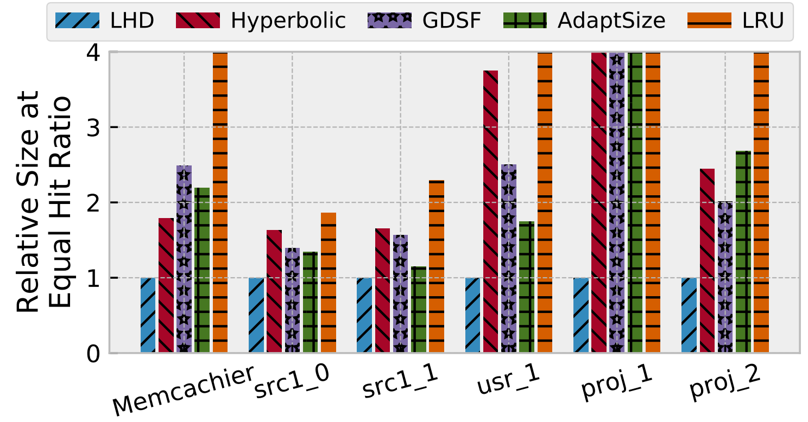
LHD needs much less space

Slide 21
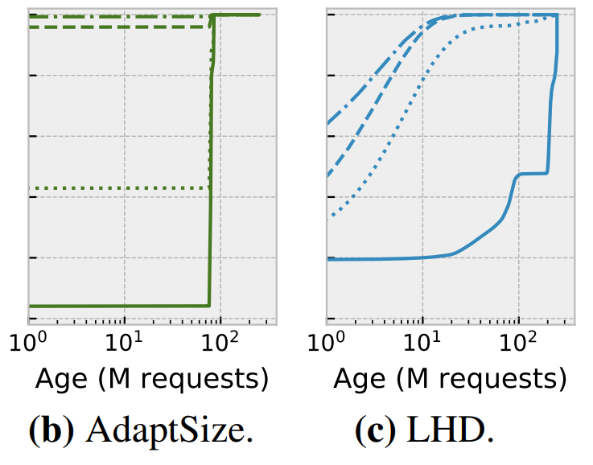
Why does LHD do better?
Case study vs. AdaptSize [Berger et al, NSDI’17]
  AdaptSize improves LRU by bypassing most large objects
Biggest objects
LHD admits all objects ➔ more hits from big objects
LHD evicts big objects quickly ➔ small objects survive longer ➔ more hits
Smallest objects

Slide 22
RankCache: Translating Theory to Practice

Slide 23
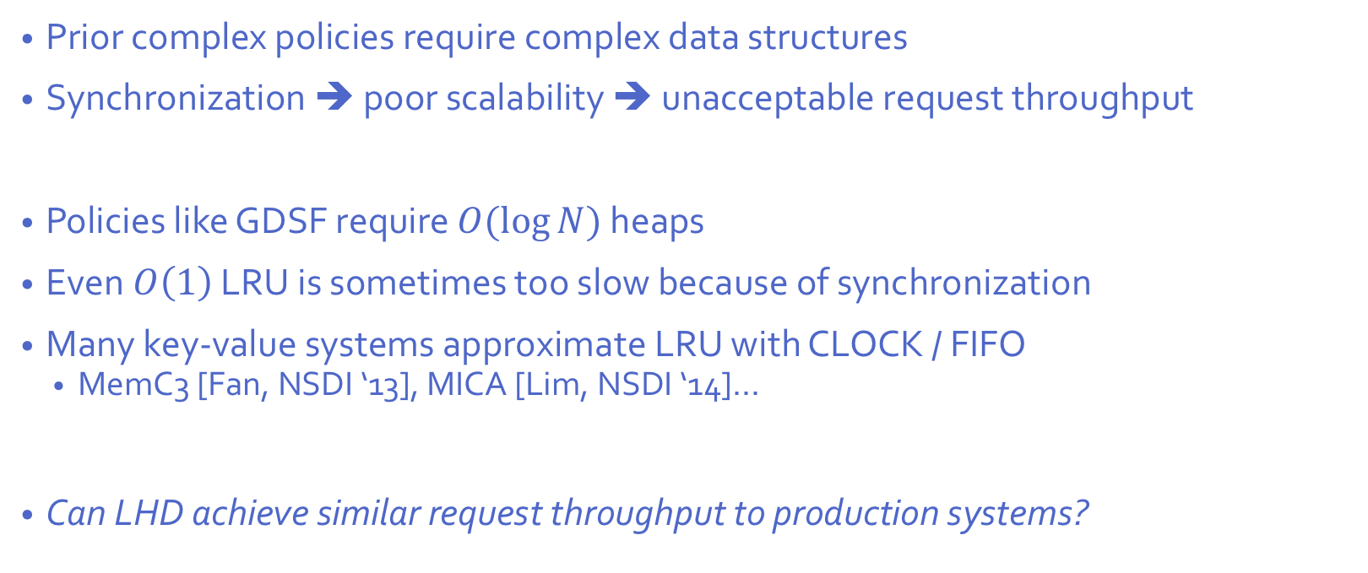
The problem
Prior complex policies require complex data structures
Synchronization ➔ poor scalability ➔ unacceptable request throughput
Policies like GDSF require $O(\log{N})$ heaps
Even $O\left(1\right)$ LRU is sometimes too slow because of synchronization
Many key-value systems approximate LRU with CLOCK / FIFO
  MemC3 [Fan, NSDI ‘13], MICA [Lim, NSDI ‘14]…
Can LHD achieve similar request throughput to production systems?

Slide 24
RankCache makes LHD fast
Track information approximately (eg, coarsen ages)
Precompute HD as table indexed by age & app id & etc
Randomly sample objects to find victim
  Similar to Redis, Memshare [Cidon, ATC ‘17], [Psounis, INFOCOM ’01],
Tolerate rare races in eviction policy

Slide 25
Making hits fast
Metadata updated locally ➔ no global data structure
Same scalability benefits as CLOCK, FIFO vs. LRU

Slide 26


Making evictions fast
No global synchronization ➔ Great scalability!
(Even better than CLOCK/FIFO!)
A
Sample
objects
Lookup hit density
(pre-computed)
B
Miss!
A
C
C
Evict E
D
F
E
E
F
G
Repeat if race detected

Slide 27
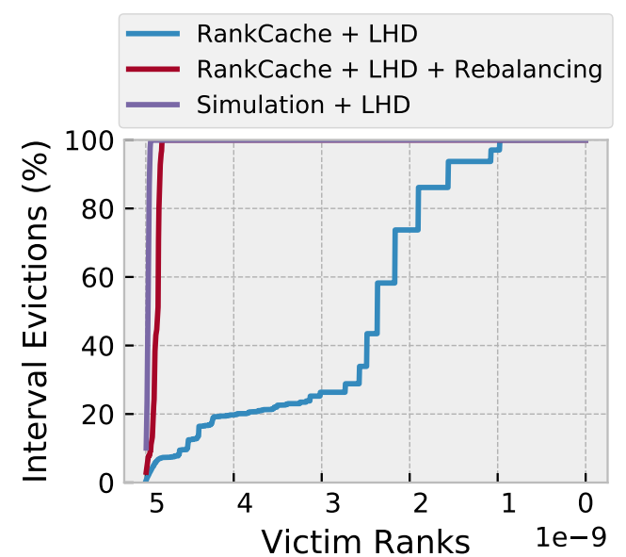
Memory management
Many key-value caches use slab allocators (eg, memcached)
Bounded fragmentation & fast
…But no global eviction policy ➔ poor hit ratio
Strategy: balance victim hit density across slab classes
  Similar to Cliffhanger [Cidon, NSDI’16] and GD-Wheel [Li, EuroSys’15]
Slab classes incur negligible impact on hit rate

Slide 28
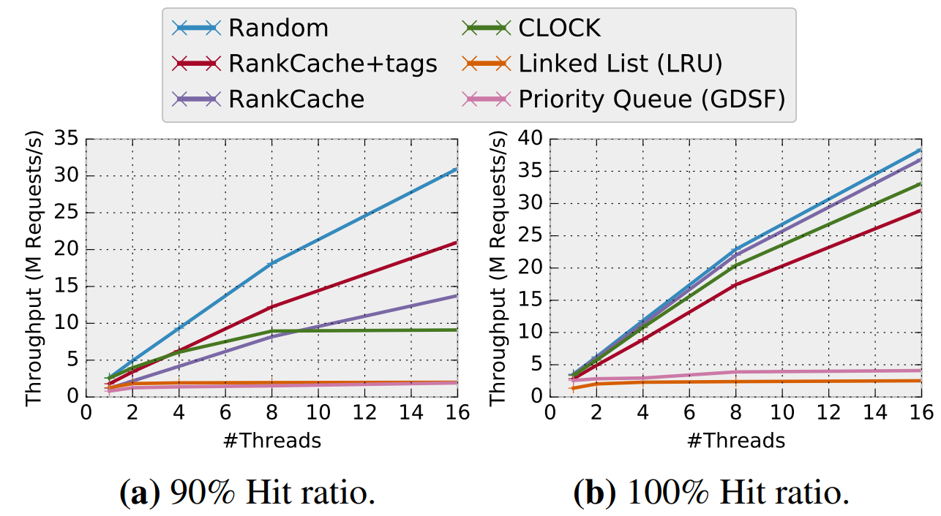
Serial bottlenecks dominate ➔ LHD best throughput
Optimization we don’t have time to talk about!
GDSF & LRU don’t scale!
CLOCK doesn’t scale when there are even a few misses!
RankCache scales well with or without misses!

Slide 29
Related Work
Using conditional probabilities for eviction policies in CPU caches
  EVA [Beckmann, HPCA ‘16, ’17]
  Fixed object sizes
  Different ranking function
Prior replacement policies
  Key-value: Hyperbolic [Blankstein, ATC ‘17], Simulations [Waldspurger, ATC ‘17], AdaptSize [Berger, NSDI ‘17], Cliffhanger [Cidon, NSDI ‘16]…
  Non key-value: ARC [Megiddo, FAST ’03], SLRU [Karedla, Computer ‘94], LRU-K [O’Neil, Sigmod ‘93]…
  Heuristic based
  Require tuning or simulation

Slide 30
Future directions
Dynamic latency / bandwidth optimization
  Smoothly and dynamically switch between optimized hit ratio and byte-hit ratio
Optimizing end-to-end response latency
  App touches multiple objects per request
  One such object evicted ➔ others should be evicted too
Modeling cost, e.g., to maximize write endurance in FLASH / NVM
  Predict which objects are worth writing to 2nd tier storage from memory

Slide 31
Thank you!

