Slide 1
Memshare: a Dynamic Multi-tenant Key-value Cache
Asaf cidon*, daniel rushton†, stephen m. rumble‡, ryan stutsman†
*Stanford University, †University of utah, ‡google inc.

Slide 2
Cache is 100X Faster Than Database
Web Server
10 ms
100 us

Slide 3
Cache Hit Rate Drives Cloud Performance
Small improvements to cache hit rate make big difference:
At 98% cache hit rate:
+1% hit rate → 35% speedup
Facebook study [Atikoglu ’12]

Slide 4
Static Partitioning → Low Hit Rates
Cache providers statically partition their memory among applications
Examples:
Facebook
Amazon Elasticache
Memcachier

Slide 5
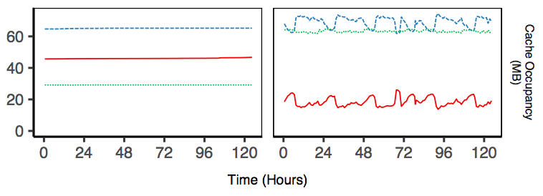
Partitioned Memory Over Time
Static Partition
No Partition
App A
App B
App C

Slide 6
Partitioned vs No Partition Hit Rates
Application | Hit Rate Partitioned | Hit Rate No Partition
Combined | 87.8% | 88.8%
A | 97.6% | 96.6%
B | 98.8% | 99.1%
C | 30.1% | 39.2%

Slide 7
Partitioned Memory: Pros and Cons
Disadvantages:
Lower hit rate due to low utilization
Higher TCO
Advantages:
Isolated performance and predictable hit rate
“Fairness”: customers get what they pay for

Slide 8
Memshare: the Best of Both Worlds
Optimize memory allocation to maximize overall hit rate
While providing minimal guaranteed memory allocation and performance isolation

Slide 9
Multi-tenant Cache Design Challenges
Decide application memory allocation to optimize hit rate
Enforce memory allocation among applications

Slide 10
Estimate Hit Rate Curve Gradient to Optimize Hit Rate

Slide 11
Estimate Hit Rate Curve Gradient to Optimize Hit Rate

Slide 12
Estimating Hit Rate Gradient
Track access frequency to recently evicted objects to determine gradient at working point
Can be further improved with full hit rate curve estimation
SHARDS [Waldspurger 2015, 2017]
AET [Hu 2016]

Slide 13
Multi-tenant Cache Design Challenges
Decide application memory allocation to optimize hit rate
Enforce memory allocation among applications

Slide 14
Multi-tenant Cache Design Challenges
Decide application memory allocation to optimize hit rate
Enforce memory allocation among applications
Not so simple

Slide 15
Slab Allocation Primer
Memcached Server
App 1
App 2

Slide 16
Slab Allocation Primer
Memcached Server
App 1
App 2

Slide 17
Slab Allocation Primer
Memcached Server
LRU Queues
App 1
App 2

Slide 18
Goal: Move 4KB from App 2 to App 1
Memcached Server
App 1
App 2

Slide 19
Goal: Move 4KB from App 2 to App 1
Problems:
Need to evict 1MB
Contains many small objects, some are hot
App 1 can only use extra space for objects of certain size
Memcached Server
App 1
App 2

Slide 20
Goal: Move 4KB from App 2 to App 1
Problems:
Need to evict 1MB
Contains many small objects, some are hot
App 1 can only use extra space for objects of certain size
Memcached Server
App 1
App 2
Problematic even for one application, see Cliffhanger [Cidon 2016]

Slide 21
Instead of Slabs: Log-structured Memory
Log segments
Log Head

Slide 22
Instead of Slabs: Log-structured Memory
Log segments
Log Head
Newly written object

Slide 23
Instead of Slabs: Log-structured Memory
Log segments
Log Head

Slide 24
Applications are Physically Intermixed
Log segments
Log Head
App 1
App 2

Slide 25
Memshare’s Sharing Model
Reserved Memory: guaranteed static memory
Pooled Memory: application’s share of pooled memory
Target Memory = Reserved Memory + Pooled Memory

Slide 26
Cleaning Priority Determines Eviction Priority
Q: When does Memshare evict?
A: Newly written objects evict old objects, but not in critical path
Cleaner keeps 1% of cache empty
Cleaner tries to enforce actual memory allocation to be equal to Target Memory
Notes:
No application is ever denied new space
Emphasize that the cleaner is an enforcement engine

Slide 27
Cleaner Pass
n - 1 survivor segments (n = 2)
n candidate segments (n = 2)
App 1
App 2

Slide 28
Cleaner Pass
n - 1 survivor segments (n = 2)
n candidate segments (n = 2)
App 1
App 2

Slide 29
Cleaner Pass
n - 1 survivor segments (n = 2)
n candidate segments (n = 2)
App 1
App 2

Slide 30
Cleaner Pass
n - 1 survivor segments (n = 2)
n candidate segments (n = 2)
App 1
App 2

Slide 31
Cleaner Pass
n - 1 survivor segments (n = 2)
n candidate segments (n = 2)
App 1
App 2

Slide 32
Cleaner Pass
n - 1 survivor segments (n = 2)
n candidate segments (n = 2)
1 free segment
App 1
App 2

Slide 33
Cleaner Pass (n = 4): Twice the Work
3 survivor segments (n = 4)
4 candidate segments (n = 4)
App 1
App 2
1 free segment

Slide 34
Application Need: How Far is Memory Allocation from Target Memory?
Log segments
Log Head
App 1
App 2

Slide 35
Within Each Application, Evict by Rank
Log segments
1
12
5
7
15
4
3
0
8
Log Head
To implement LRU: rank = last access time
App 1
App 2

Slide 36
Cleaning: Max Need and then Max Rank
n segments n-1 segments
Rank 2
Rank 1
Rank 0
Rank 3
Max Need?
Max Rank?
 | Need
App 1 | 0.8
App 2 | 1.4
App 3 | 0.9

Slide 37
Cleaning: Max Need and then Max Rank
n segments n-1 segments
Rank 2
Rank 1
Rank 0
Rank 3
Max Need? → App 2
Max Rank?
 | Need
App 1 | 0.8
App 2 | 1.4
App 3 | 0.9

Slide 38
Cleaning: Max Need and then Max Rank
n segments n-1 segments
Rank 2
Rank 1
Rank 0
Rank 3
Max Need? → App 2
Max Rank? → Rank 2
 | Need
App 1 | 0.8
App 2 | 1.4
App 3 | 0.9

Slide 39
Cleaning: Max Need and then Max Rank
n segments n-1 segments
Rank 1
Rank 0
Rank 3
Rank 2
Max Need?
Max Rank?
 | Need
App 1 | 0.9
App 2 | 0.8
App 3 | 1.2

Slide 40
Cleaning: Max Need and then Max Rank
n segments n-1 segments
Rank 1
Rank 0
Rank 3
Rank 2
Max Need? → App 3
Max Rank?
 | Need
App 1 | 0.9
App 2 | 0.8
App 3 | 1.2

Slide 41
Cleaning: Max Need and then Max Rank
n segments n-1 segments
Rank 1
Rank 0
Rank 3
Rank 2
Max Need? → App 3
Max Rank? → Rank 1
 | Need
App 1 | 0.9
App 2 | 0.8
App 3 | 1.2

Slide 42
Trading Off Eviction Accuracy and Cleaning Cost
Eviction accuracy is determined by n
For example: rank = time of last access
When n → # segments: ideal LRU
Intuition: n is similar to cache associativity
CPU consumption is determined by n

Slide 43
Trading Off Eviction Accuracy and Cleaning Cost
Eviction accuracy is determined by n
For example: rank = time of last access
When n → ∞: ideal LRU
Intuition: n is similar to cache associativity
CPU consumption is determined by n
“In practice Memcached is never CPU-bound in our data centers. Increasing CPU to improve the hit rate would be a good trade off.”
⁻ Nathan Bronson, Facebook

Slide 44
Implementation
Implemented in C++ on top of Memcached
Reuse Memcached’s hash table, transport, request processing
Implemented log-structured memory allocator

Slide 45
Partitioned vs. Memshare
Application | Hit Rate Partitioned | Hit Rate Memshare (50% Reserved)
Combined | 87.8% | 89.2%
A | 97.6% | 99.4%
B | 98.8% | 98.8%
C | 30.1% | 34.5%

Slide 46
Reserved vs. Pooled Behavior
Combined Hit Rates
90.2% 89.2% 88.8%
App A
App B
App C

Slide 47
State-of-the-art Hit rate
Misses reduced by 40%
Combined hit rate increase: 6% (85% → 91%)

Slide 48
State-of-the-art Hit Rate Even for Single Tenant Applications
Policy | Memcached | Memshare (100% Reserved)
Average Single Tenant Hit Rate | 88.3% | 95.5%

Slide 49
Cleaning Overhead is Minimal

Slide 50
Cleaning Overhead is Minimal
Modern servers have 10GB/s or more!

Slide 51
Related Work
Optimizing memory allocation using shadow queues
Cliffhanger [Cidon 2016]
Log-structured single-tenant key-value stores
RAMCloud [Rumble 2014] and MICA [Lim 2014]
Taxing idle memory
ESX Server [Waldspurger 2002]

Slide 52
Summary
First multi-tenant key-value cache that:
Optimizes share for highest hit rate
Provides minimal guarantees
Novel log-structured design
Use cleaner as enforcer

Slide 53
Appendix

Slide 54
Idle Tax for Selfish Applications
Some sharing models do not support pooled memory, each application is selfish
For example: Memcachier’s Cache-as-a-Service
Idle tax: reserved memory can be reassigned if idle
Tax rate: determines portion of idle memory that can be reassigned
If all memory is active: target memory = reserved memory

Slide 55
Partitioned vs. Idle Tax
Application | Hit Rate Partitioned | Hit Rate Memshare Idle Tax
Combined | 87.8% | 88.8%
A | 97.6% | 99.4%
B | 98.8% | 98.6%
C | 30.1% | 31.3%

Slide 56
State-of-the-art Hit rate

Slide 57
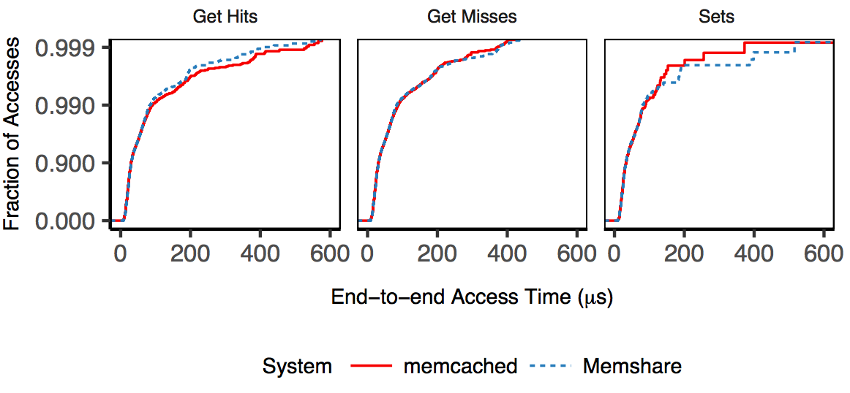
Nearly Identical Latency

